Slide 1
Different types of violence and ways to prevent them

Slide 2
Physical violence

Slide 3
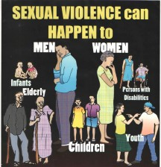
Sexual violence

Slide 4
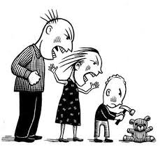
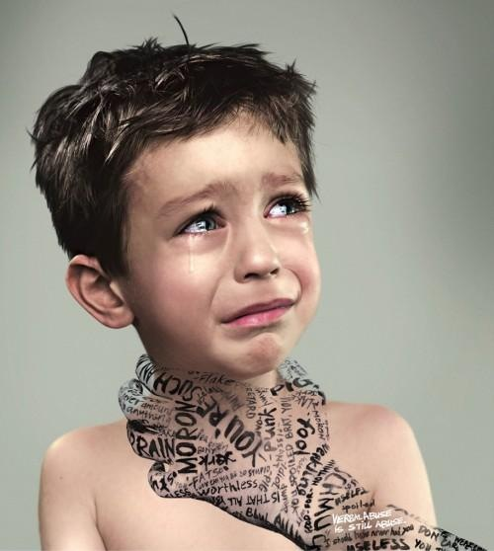
Psychological violence

Slide 5
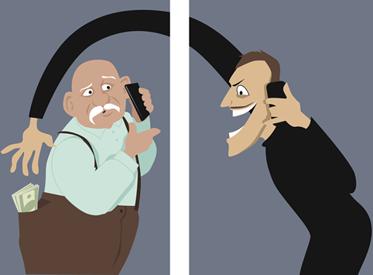
Financial violence

Slide 6
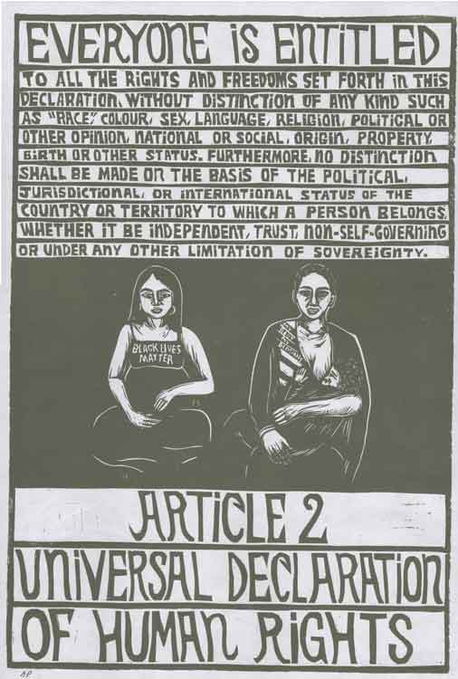
Article 2 and 5

Slide 7
Violence is never the answer

Slide 8
The end
Presentation made by:
Pedro Dantas
Gonçalo Carvalho
Bernardo Dores
Gonçalo Dores
Nuno Tiago

